Slide 1
Assignment 11 (ATM)

Slide 2
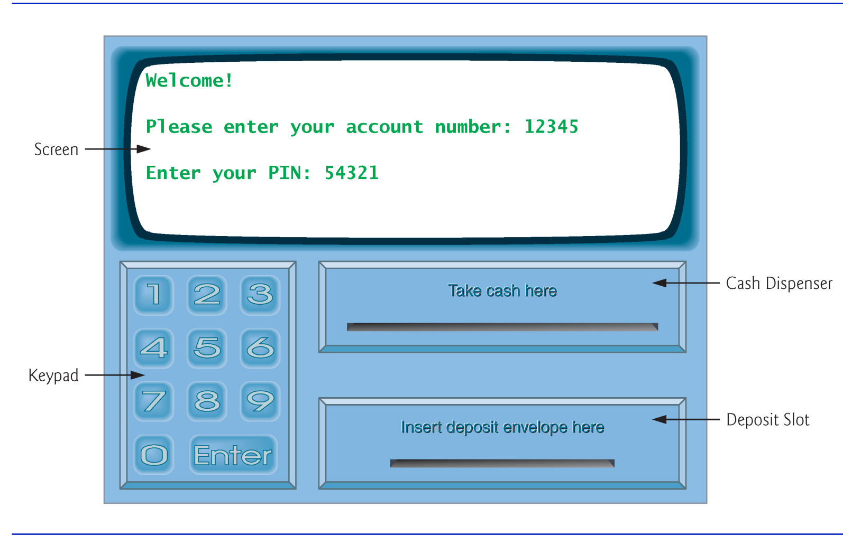

Slide 3
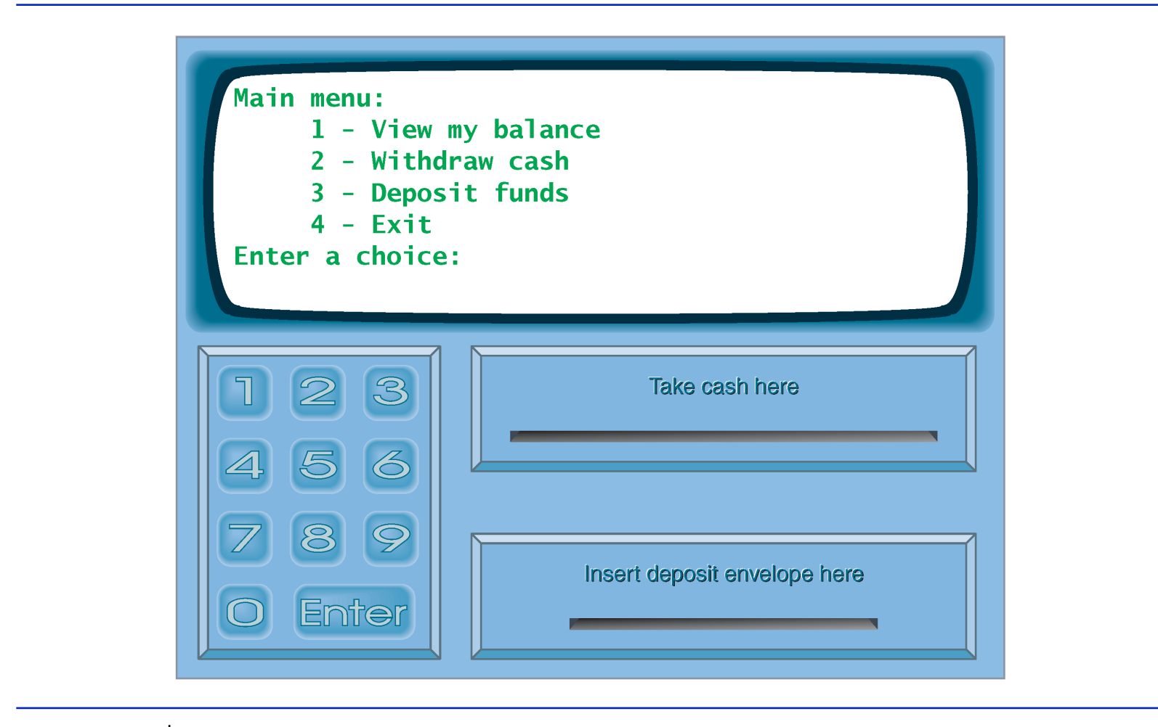

Slide 4
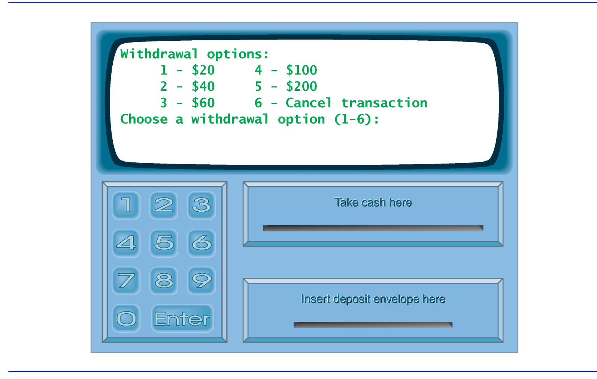

Slide 5
int main()
{
bool userAuthenticated = false; // whether user is authenticated
int currentAccountNumber = 0; // current user's account number
Account account1( 12345, 54321, 1000.0, 1200.0 );
Account account2( 98765, 56789, 200.0, 200.0 );
vector< Account > accounts; // vector of the bank's Accounts
// add the Account objects to the vector accounts
accounts.push_back( account1 );
accounts.push_back( account2 );

Slide 6
// welcome and authenticate user; perform transactions
while ( true )
{
// loop while user is not yet authenticated
while ( !userAuthenticated )
{
cout << "\nWelcome!" << endl;
authenticateUser( userAuthenticated, currentAccountNumber,
accounts ); // authenticate user
}
// display the main menu and perform transactions
performTransactions( currentAccountNumber, accounts,
remainingBills );
userAuthenticated = false;
currentAccountNumber = 0;
cout << "\nThank you! Goodbye!" << endl;
}
}

Slide 7
// attempt to authenticate user against database
void authenticateUser( bool &userAuthenticated,
int &currentAccountNumber, vector< Account > &accounts )
{
cout << "\nPlease enter your account number: ";
int accountNumber;
cin >> accountNumber; // input account number
cout << "\nEnter your PIN: ";
int pin;
cin >> pin; // input PIN
Account * const userAccountPtr = getAccount( accountNumber,
accounts );
// if account exists, return result of Account function validatePIN
if ( userAccountPtr != NULL )
userAuthenticated = userAccountPtr->validatePIN( pin );
else
userAuthenticated = false; // account number not found
// check whether authentication succeeded
if ( userAuthenticated )
currentAccountNumber = accountNumber; // save user's account #
else
cout << "Invalid account number or PIN. Please try again.\n";
}

Slide 8
// retrieve Account object containing specified account number
Account * getAccount( int accountNumber, vector< Account > &accounts )
{
// loop through accounts searching for matching account number
for ( size_t i = 0; i < accounts.size(); i++ )
{
// return current account if match found
if ( accounts[ i ].getAccountNumber() == accountNumber )
return &accounts[ i ];
}
return NULL; // if no matching account was found, return NULL
}

Slide 9
// display the main menu and perform transactions
void performTransactions( int &currentAccountNumber,
vector< Account > &accounts )
{
// enumeration constants represent main menu options
enum MenuOption { BALANCE_INQUIRY = 1, WITHDRAWAL, DEPOSIT, EXIT };
// local pointer to store transaction currently being processed
BalanceInquiry *balanceInquiryPtr;
Withdrawal *withdrawalPtr;
Deposit *depositPtr;
const int INITIAL_REMAINING_BILLS = 500;
int remainingBills = INITIAL_REMAINING_BILLS;
bool userExited = false; // user has not chosen to exit
// loop while user has not chosen option to exit system
while ( !userExited )
{
// show main menu and get user selection
int mainMenuSelection = displayMainMenu();

Slide 10
// decide how to proceed based on user's menu selection
switch ( mainMenuSelection )
{
// user chose to perform one of three transaction types
case BALANCE_INQUIRY:
// create new BalanceInquiry transaction
balanceInquiryPtr =
new BalanceInquiry( currentAccountNumber, accounts );
balanceInquiryPtr->execute();
delete balanceInquiryPtr;
break;
case WITHDRAWAL:
// create new Withdrawal transaction
withdrawalPtr = new Withdrawal( currentAccountNumber,
accounts, remainingBills );
withdrawalPtr->execute();
delete withdrawalPtr;
break;
case DEPOSIT:
// create new Deposit transaction
depositPtr = new Deposit( currentAccountNumber,
accounts );
depositPtr->execute();
delete depositPtr;
break;

Slide 11
case EXIT: // user chose to terminate session
cout << "\nExiting the system..." << endl;
userExited = true; // this ATM session should end
break;
default: // user did not enter an integer from 1-4
cout << "\nYou did not enter a valid selection. Try
again." << endl;
break;
} // end switch
} // end while
}

Slide 12
// display the main menu and return an input selection
int displayMainMenu()
{
cout << "\nMain menu:" << endl;
cout << "1 - View my balance" << endl;
cout << "2 - Withdraw cash" << endl;
cout << "3 - Deposit funds" << endl;
cout << "4 - Exit\n" << endl;
cout << "Enter a choice: ";
int choice;
cin >> choice;
return choice; // return user's selection
}

Slide 13
class Account
{
public:
Account( int theAccountNumber, int thePIN,
double theAvailableBalance,
double theTotalBalance ); // constructor sets attributes
bool validatePIN( int userPIN ) const; // is user-specified PIN
correct?
double getAvailableBalance() const; // returns available balance
double getTotalBalance() const; // returns total balance
void credit( double amount ); // adds an amount to the Account
balance
void debit( double amount ); // subtracts an amount from the
Account balance
int getAccountNumber() const; // returns account number
private:
int accountNumber; // account number
int pin; // PIN for authentication
double availableBalance; // funds available for withdrawal
double totalBalance; // funds available + funds waiting to clear
};

Slide 14
class BalanceInquiry
{
public:
BalanceInquiry( int userAccountNumber,
vector< Account > &atmAccounts ); // constructor
void execute(); // perform the balance inquiry transaction
private:
int accountNumber; // indicates account involved
vector< Account > &accounts; // reference to the vector of the
bank's Accounts
// get pointer to Account object in "accounts" whose account
number is equal to "accountNumber"
Account * getAccount( int accountNumber,
vector< Account > &accounts );
};

Slide 15
class Withdrawal
{
public:
Withdrawal( int userAccountNumber, vector< Account > &atmAccounts,
int &atmRemainingBills );
void execute(); // perform the withdrawal
transaction
private:
int accountNumber; // indicates account involved
vector< Account > &accounts; // reference to the vector of the
bank's Accounts
int amount; // amount to withdraw
int &remainingBills; // number of $20 bills remaining
// get pointer to Account object in "accounts" whose account
number is equal to "accountNumber"
Account * getAccount( int accountNumber,
vector< Account > &accounts );
// display a menu of withdrawal amounts and the option to cancel;
// return the chosen amount or 0 if the user chooses to cancel
int displayMenuOfAmounts() const;
};

Slide 16
class Deposit
{
public:
Deposit( int userAccountNumber, vector< Account > &atmAccounts );
void execute(); // perform the deposit transaction
private:
int accountNumber; // indicates account involved
vector< Account > &accounts; // reference to the vector of the
bank's Accounts
double amount; // amount to deposit
// get pointer to Account object in "accounts" whose account
number is equal to "accountNumber"
Account * getAccount( int accountNumber,
vector< Account > &accounts );
double promptForDepositAmount() const; // prompt user to enter a
deposit amount in cents
};

